Slide 1
Tom’s Jaunt Through the Ears and > 60 Years.
for HLAA Downeast Chapter (Maine).
Jaunt = short trip for pleasure, per https://ahdictionary.com/word/search.html?q=jaunt
Tom Watson III. Feb 15, 2024.

Slide 2
Outline:
Who I am; intro to HLAA Downeast Chapter in Maine.
Early years with ok ears; things that prepared me for hearing loss.
College changed hearing; sign language; technology; history; etc.
Career in medical software.
Social media + internet + apps.
Retirement; ears move me.
Advocacy for HOH folks.
Contact info; other organizations.
Key points: major impact; emotions + optimism; what did/not work.

Slide 3
Autobiography of Tom Watson III.
See slightly longer bio via About page of HLAA Downeast Chapter at https://hearinglossmaine.org/about/biographies/
2020’s: plague led to further advocacy; changed from HOH to deaf thus final hearing aid; found two phone apps that help; became officer for our chapter during its formation.
2010’s: going “over the hill” was more like a cliff; initial advocacy for HOH at work; retired to Maine then moved again twice due to ears; ASL won’t stick; cochlear implant won’t help.
2000’s: found Facebook; focus on work; play D&D medieval basis + dissipate frustrations.
1990’s: first hearing aid; intro to Deaf culture; began using internet.
1980’s: hearing loss triggered 11 years before noticed; graduated college = computers + history of technology; began 25 year career programming at medical software company; speed reading; intro to sign language (ASL).
1970’s and earlier: knights; nature + eyeglasses + house moves = outsider (pun).

Slide 4
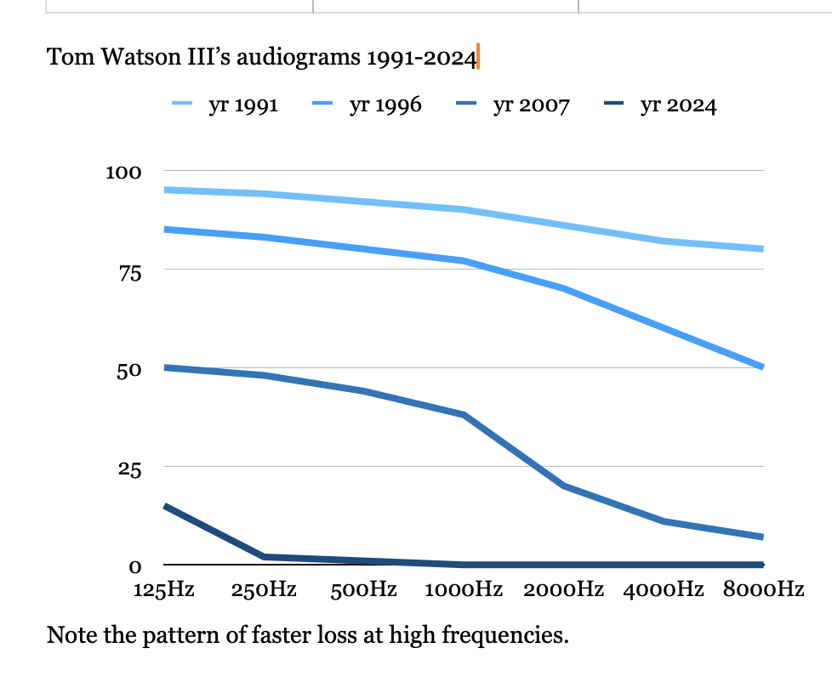

Slide 5
Early Years:
Ears ok except at highest frequencies.
Nature hikes + magazines; 3 house moves; eyeglasses; these made me outsider.
Vision decline annoying and noticeable.
Read an entire unabridged dictionary.

Slide 6
College:
Ears seemed ok; actually hearing loss triggered by dorm noise.
Computers + history + technology.
Big obstacle (not ears) led to realization optimism is key to own survival; I dream therefore I am.
Intro’d to ASL + SCA via extracurricular activity.
Learned how to learn.

Slide 7
Career:
Ears noticed by me when TV difficult; by family when tried to be ninja climbing stairs late at night - they heard elephants.
Began work doing both programming and using phone to discuss what clients desired; saw code used to handle names that sound similar; early easy then needed hearing aid + briefly an amplifier; later got too difficult so phone eliminated from duties (company made that part its own job).
Thrice got notice of jury duty; did not happen since told them could not guarantee fairness to everyone due to mishearing; big difference between “do” and “do not”.
Vacations used to travel (e.g. Thailand) since knew hearing loss would get worse.
Bounced every 5 years among several company buildings in MA thus lost health records in the shuffle; late in career emails began being misinterpreted by recipients; new buildings far out of state + further hearing loss led to early retirement.
Near end of career gave superiors more info about how severe hearing loss affected job; they continued to be responsive.

Slide 8
Social media + internet + apps:
Found internet almost as soon as it went public; chat rooms and email most useful.
Facebook hooked me at moderate loss stage; enjoy both humorous posts and capability to stay in touch with friends from earlier locations without phone hassles.
Began to maintain a website for another organization (SCA) shortly after retirement; thought knew what job entailed until volunteered for same duty in HLAA chapter = oh my!
Communicated with others via G-Meet which had captions early in plague; Zoom took most folks and did not have captions - thus made #ZoomIsAwful to get their attention.
Apps = Sprint CapTel ok but slow, Notes good for gist + review later, Ava + Otter + etc for groups never got setup or external microphone, innocaption good for calls but 4 employees and 2 hours to set it up. CaptionCall never got better than Sprint’s despite more than a decade later. Nothing works for all situations - division seems to be phone calls vs in-person 1-on-1 vs small meetings.
Kept phone mostly to fill out online forms; frustrated when the form blocked “text me”.

Slide 9
Retirement; ears move me:
Trip to New Zealand + Australia as transition to retirement went well due to hearing aids; boat ride nearly lost aids; 1 frustrating day entirely spent dealing with credit card company on phone; 1 flight nearly missed when they changed terminal but nothing visible on airport’s screens til last possible moment.
Moved to Maine; internet out for full week each of first 4 years = moved over 1 town; text to 911 began in ME shortly after that = drat; ears no longer heard approaching vehicles + too brief visibility = moved to other side of first town.
Lost drivers license to snow shoveling; happened to find BMV form `Certification of Deafness or Hard of Hearing`; license now has an icon on it to let police (etc.) know why I might not respond to verbal commands.
Evaluated for c.i. = nope; drove 5 hours each way just to schedule an appointment at MA Eye & Ear due to regulation restrictions leaving voice phone sole other option.
Trying to convince talkers they were wasting our time: “Voices might as well be coming from Andromeda galaxy” and “I hear in-person at arm’s length”.

Slide 10
Advocacy for HOH folks:
Read Facebook posts on HOH + deaf groups and replied when no mentions yet of something familiar; got valuable tips re c.i. on another group - then added that they seem to focus on $ versus whether it will truly work; watching a Caption Quality group + posting some examples of poor captions; post things such as “Frustrated by phone” on my feed.
Always let folks know I was HOH once got to severe stage - vast majority paused to listen; pushed teachers and presenters to add captions even when latter took 2 weeks for a university to set up (Zoom).
HLAA 2023 Convention first time saw captions from live speakers in an auditorium-ish setting; after 10 years trying to convince another Con to do “something” for HOH finally had a specific thing I knew worked and a contact to explain to them how to do it.
HLAA Downeast Chapter website + flyers + mentioned at stores and libraries; share some post with my Facebook friends.
What will make our chapter different from other advocates?

Slide 11
Contact info + other organizations:
Email tom3w@earthlink.net or via HearingLossMaine.org contact form.
ALDA.org = Association of Late Deafened Adults.
SCA.org; https://wiki.eastkingdom.org/wiki/Thomas_of_Wyndriche includes medieval heraldry with ear and links to Silent Heraldry using ASL; recently started using assistive listening devices (etc.) at large gatherings such as East Kingdom courts.

Slide 12
Key points:
Hearing loss has a major impact on our lives; initial loss not always obvious.
Emotions can be sneaky; frustration is common; humor and play helps; stay optimistic about future.
What worked: speed reading for captions on TV etc.; hearing aids in big groups and 1-1 until Severe stage then just with a few people until middle of Profound stage; chat rooms + Facebook; G-meet then recently Zoom; switching to jobs that needed less talk; free Notes app 70% when few folks + near speaker; 2 of 12 phone captioning methods; asking speaker to rephrase what they said if third repeat still unclear; advocacy for HOH folks.
What failed: Amplifiers; shouting; voices via phones + computers; many speech-to-text apps; too many people talking over each other; windy areas; Zoom until recently; lip reading; ASL.
Final questions?

